Slide 1
Cross-Scale Commons
Investigating scale issues in distributed commons

Slide 2
Topics
Fisheries collapse background
Limitations of a scale focus
Distributed commons
Theoretical implications
Potential for local-driven governance

Slide 3
Fisheries Collapse

Slide 4
Fisheries Collapse
Problems for food, fishers, ecosystems, endangered species
Solutions through quotas, gear, reserves, community management
Hampered by entrenchment, governance, communication, uncertainty, subsides, incentives
Poor CPR traits… but history of successes

Slide 5
The need for a local scale
Failures of government management
Capacity for cooperation
Stakeholder engagement
Local knowledge and adaptation
Scale as perspective

Slide 6
The need for cross-scale
Co-management
  Weakness of only local or gov. control
Impact of “outside” world
Local needs for government and market
  Data, protection, legitimization
Emergent patterns (and resilience)
Scale-independence

Slide 7
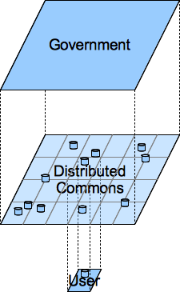
The Distributed Commons
Relationship is more than larger and smaller.
Separating the effects of scale and resolution.

Slide 8
DC Characteristics
Non-excludability, subtractability of use
Spatially distributed exploitation and users
Effects have greatest impact locally
  Mobile resource units or medium
No clear boundary at user level
  Impact from “beyond boundary”

Slide 9
DC Consequences
Differences in perspective
  Core, community, outsiders
Greater uncertainty
Problems of blame, control, benefits, and coordination
Diminished property rights, but possible
Cross-boundary benefits

Slide 10
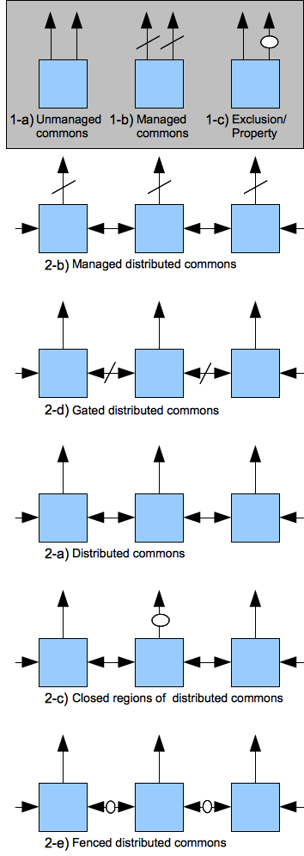
Conceptual Model
Top: Aggregate management options
Bottom: Distributed management options

Slide 11
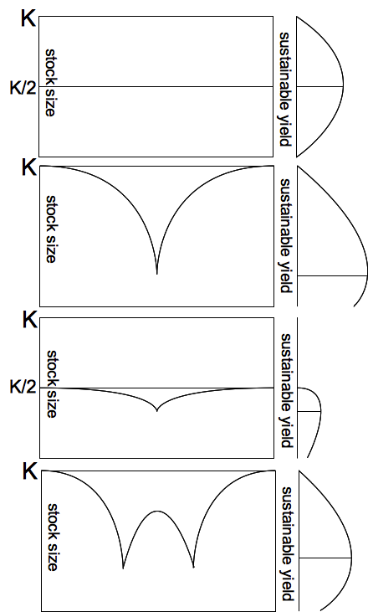
Exploitation Regimes
Uniform exploitation
Point exploitation
Point and uniform skins
Combined point sinks

Slide 12
Distanced Prisoner’s Dilemma
Basic prisoner’s dilemma:
Simple fishery payouts:
Adding distance:

Slide 13
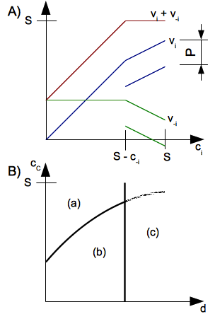
Fishery Game Regimes
A) Payouts against a constant player
B) Varying distance from (a) prisoner’s dilemma, (b) weak dominance, (c) optimal exploitation

Slide 14
Capacity for Governance
Wider range of theoretical responses
Co-management needed
  Local communities more aware
  Government setting conditions right
    Data gathering, protection from env damage, enforcement, legitimization, enabling legislation, cultural revitalization, capacity building
Natural scope to manage vs. gov interest
Leadership, cohesion, quotas, MPAs
Resilience through use patterns

